Slide 1
Loan Application Risk Analysis
Sarika Kolekar

Slide 2
Problem Statement
Loan providing companies find it difficult to conclude whether to provide load or not due to insufficient credit history.
Two types of risks are associated with the such companies decision
Approved loan for the client with payment difficulties
Rejected loan for customers paying on time.
Companies usually take below decisions on Loan Applications
Approved – Approved loan
Rejected – Rejected loan by company
Unused offer – Approved loan but customer didn’t proceed further
Cancelled – Customer cancelled loan

Slide 3
Problem Statement cont..
Find pattern with provided data for,
Denying loan
Reducing amount of loan
Lending with high interest rate
Strong indicators for default

Slide 4
Assumptions
In DAYS_EMPLOYED column for value “365243” assumed as clint worked 243 days per year.
Customers with this value assumed to complete there education at standard age

Slide 5
Approach and Methodology
Deleting columns having more than 40% data missing from both dataset a s it will skew results
Deleting Boolean columns having 90%+ same value as will not be able to derive any conclusion using those columns
Creating new category as unknown wherever applicable
Imputing Categorical missing values and values very less( <0.5%) with mode.
Imputing Numerical values with Median(where outliers present) and with mode where distribution will deviate when used mean/median
Derive values using other columns where necessary
Correct column/row values wherever applicable

Slide 6
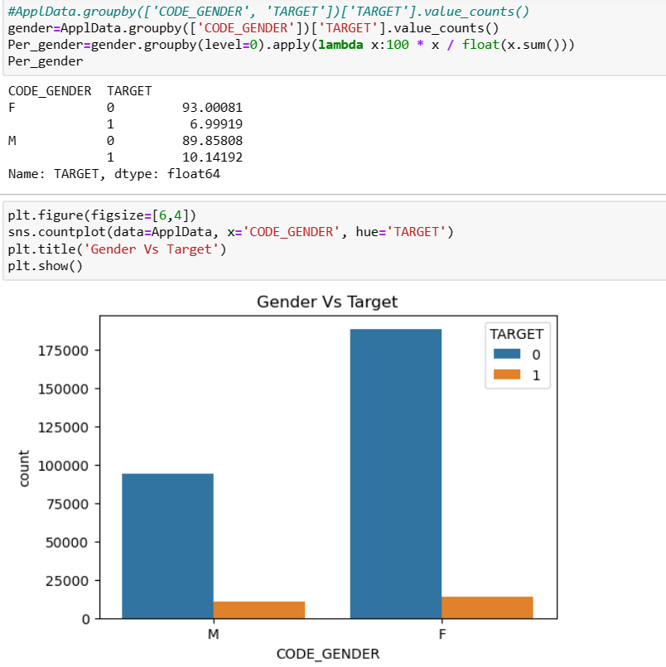
Univariate/Bivariate/Multivariate Analysis
Imbalance ration of Target variable is 1 : 11.38
Female customers applying for loan are higher but % male defaulter is higher than females customers.

Slide 7
Univariate/Bivariate/Multivariate Analysis Cont..
Major population of loan applicant fall between 30-50 years bucket
Above 60 years customer has least default rate
Employment days are calculated for junk value using birth days and education columns
Customers with employment years less than 5 years are major chunk of loan application customers out of which more than 10% are defaulters
90% customers have minimum secondary education
Low skilled laborers are having high default rate %
Unemployed and maternity leave have high default rate
Apartment/House customers are higher applicants out of almost ~8% are defaulters
Most customers are married and among them civil married have higher default rate(9.95%) than others and widowers are least likely to default(5.82%)

Slide 8
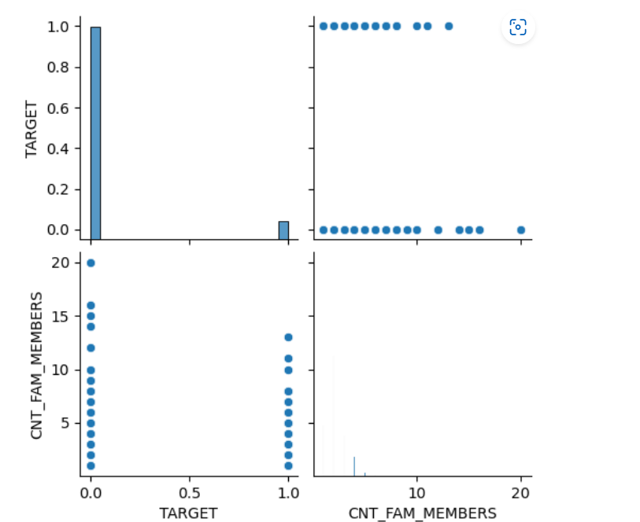
Univariate/Bivariate/Multivariate Analysis Cont..
Rented apartment and living with parent customers have high default rate where as office apartment customers have least default rate 6.57
No linear relationship between age, target, employment years, income and children count
No linear relationship between target and family members

Slide 9
Univariate/Bivariate/Multivariate Analysis Cont..
Above 100k annuity customers least likely to default and hence safest to provide loan to them Below 50k good amount customers have leats default %
No linear relationship in number of children and income.
Through customers with 6 children have high default rate but customers having more children have either 100% default or repayment rate.
Above 200K income as income increases there is slight decrease in default rate. Below 50k have high default rate.
Above 100k annuity customers least likely to default(2%) hence safe to provide loan
Below 50k goods price has high % repayment(95.55%) , such customers are safe to provide loan with
Customer Registration city is not lining city show high default rate 12.25%. Similar trend for registration city not work city with 10.61 default %

Slide 10
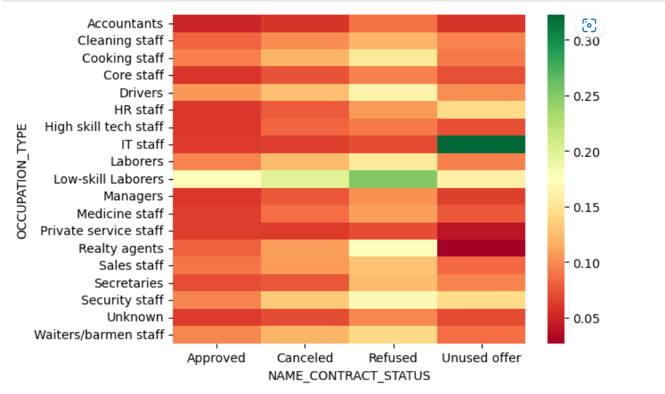
Univariate/Bivariate/Multivariate Analysis Cont..
No linear relationship between name contract status and Occupation type

Slide 11
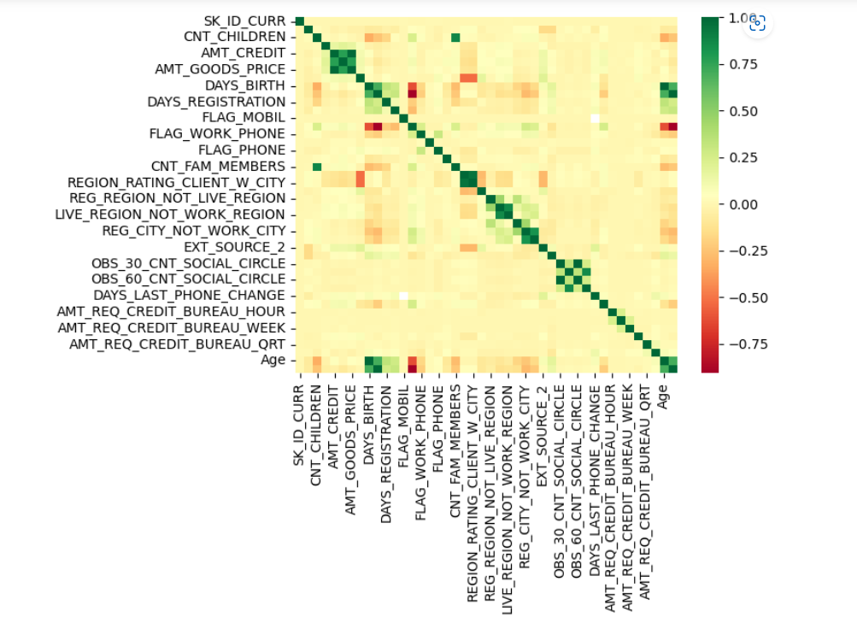
Univariate/Bivariate/Multivariate Analysis Cont..
Correlation matrix

Slide 12
Conclusions
Factors driving default %
Males have high default rate(10.14%)
Below 30 year old are more likely to default(11.46%)
Below 5 years employment have high default % (10.57%)
Lowe education customers are most in default rate
Maternity leave and unemployed have high default rate with 40% and 36.36% value which is on higher end
Cleaners, construction, industry type 1, Restaurant,Transport: type 3, Trade: type 3, self_employed,Industry: type 8, Industry: type 13 have high defaulter rate
Low skilled labors have high default rate 17%
Civil marriage and singles have high default rate
Customers living with parent or in rented apartment have high default rate

Slide 13
Conclusions cont..
Factors Driving Repayors %
Above 60 years old are safe to provide loan with 95% repayment rate
Above 40 years of employment have high repayor rate (94.9%)
Academic degree holding customers high repayor rate(98.17%)
Transport type 1, Trade type 4 , security ministers are safe category with low default rate
Accounts have 95+% repayors rate
Widowers have high repayment rate
Customers living in office apartment have high repayment rate(93.43%)

Slide 14
Recommendation
Businessman are safest category to provide loan and can be offered privileged interest which may attract more of these customers
Overall low skilled labours have high default % can be offered with high interest rate loans
Rejection and cancellation reasoning documenting can further give insight as 88% and 90.82% repayors respectively of previously rejected loans

